Slide 1
IDE

Slide 2
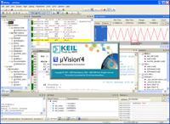
MDK Microcontroller Development Kit
Keil MDK is the most comprehensive software development solution for ARM Cortex-M microcontrollers. It includes IDE, C/C++ compiler, debugger, Software Pack management, and CMSIS. MDK Version 5 Software Packs add device support and software components that are managed using the new Run-Time Environment (RTE).

Slide 3
Components of MDK
MDK Core：
µVision IDE and Debugger.
ARM C/C++ Compiler toolchain.
Pack Installer for managing Software Packs.
Software Packs：
Device Family Packs add device support and example projects for evaluation boards.
CMSIS is a standard software framework for Cortex-M microcontrollers.
MDK-Professional Middleware adds software components for communication, file storage and graphic displays.

Slide 4
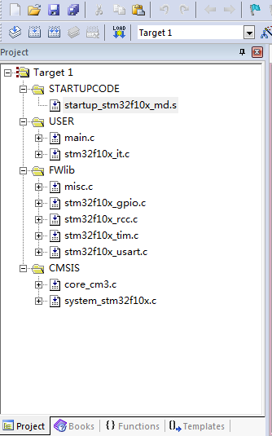
Project directory

Slide 5
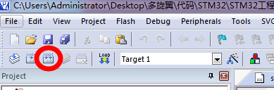
Building

Slide 6
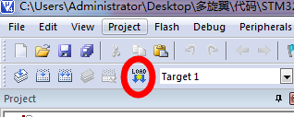
Download

Slide 7
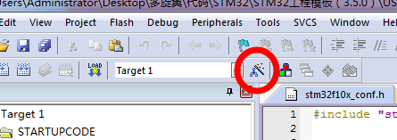
Target options

Slide 8
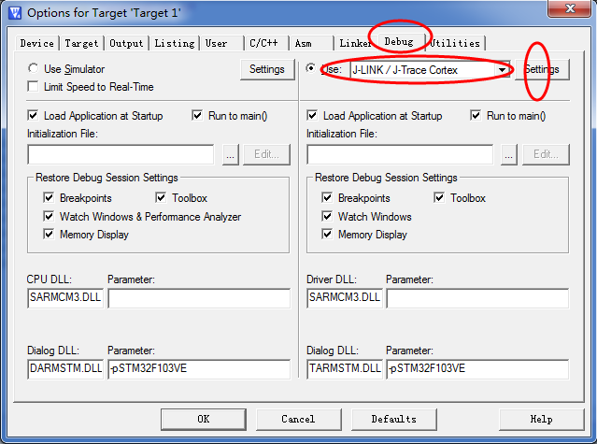
Target options

Slide 9
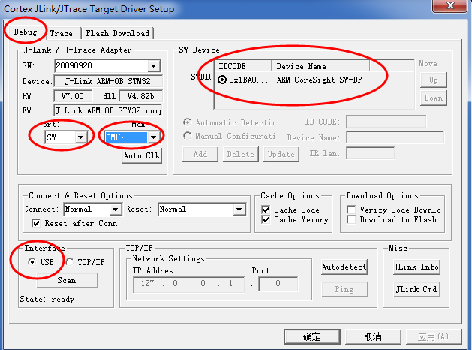
Debug settings

Slide 10
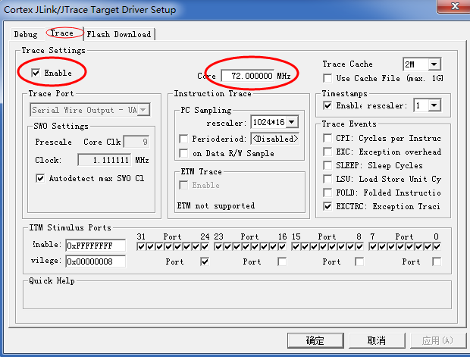
Debug settings

Slide 11
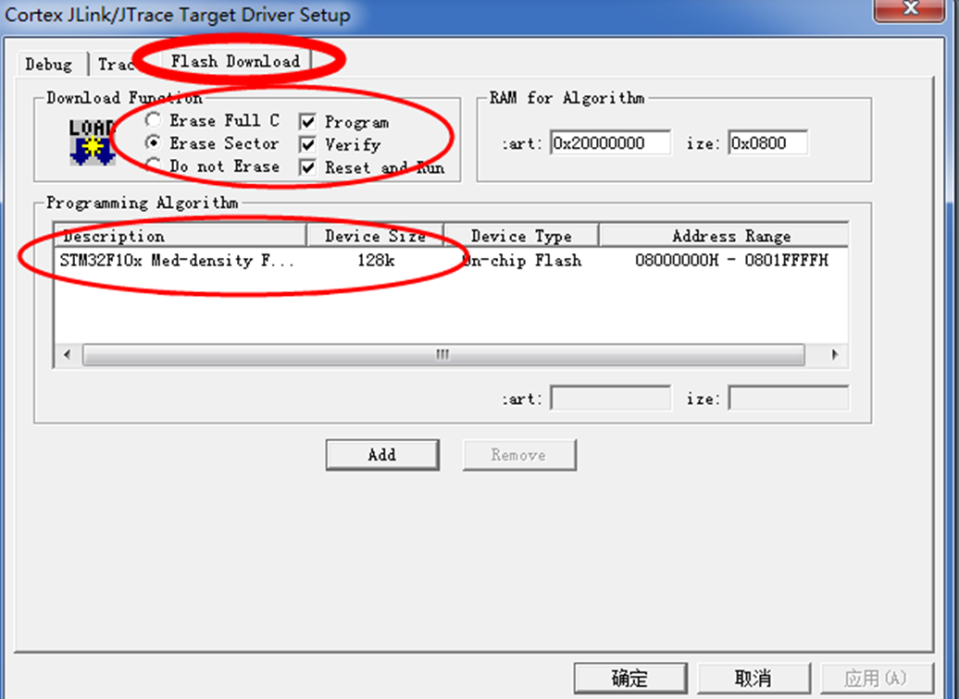
Debug settings

Slide 12
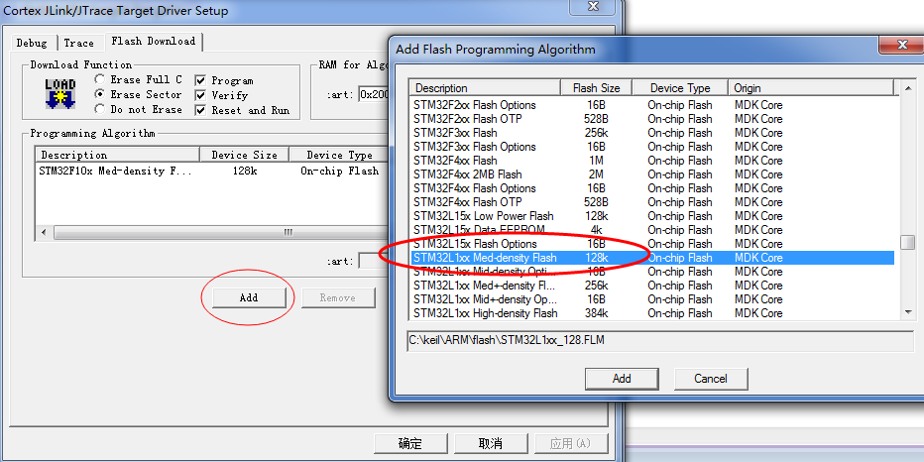
Debug settings

Slide 13
About Ground Station
Alpha for Windows developed by Filter Innovation

